Slide 1
Die Geschichte der
FOTOGRAFIE
Jurek Aita - Fotis Mertzanidis - Maximilian Glomb

Slide 2
Gliederung
01
Background & World War II Context
06
Wave 1: The First Strike (7:55 AM)
02
The Road to War: USA vs Japan
07
Wave 2: The Attack Continues (8:54 AM)
03
Admiral Yamamoto's Secret Plan
08
Massenmedium Fotografie
04
The Japanese Attack Fleet
09
Porträtfotografie & Inszenierung
05
December 7, 1941 — Timeline
10
Selbstbild vs Fremdbild

Slide 3
World War II: Setting the Stage
The world in 1941 was at war.
Germany, led by Adolf Hitler, had invaded most of Europe. Italy and Japan joined Germany, forming the Axis Powers.
The United States was NOT yet in the war.
Most Americans wanted to stay neutral and out of the conflict.
But everything changed on one December morning in Hawaii...
The World In 1941
Germany (Axis) — Controlling Most Of Europe
Japan (Axis) — Expanding Across Asia
Britain (Allied) — Fighting Germany Alone
USA — Neutral — For Now!
Quick Fact
WWII lasted 1939–1945. It involved over 30 countries and cost more than 70 million lives — the deadliest conflict in history.
Pearl Harbor: A Day That Changed History | Slide 3 of 20

Slide 4
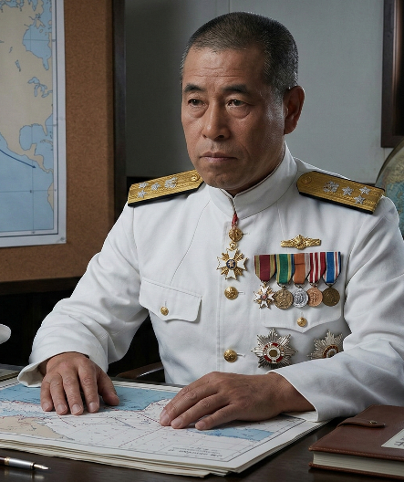
Admiral Yamamoto's Secret Plan
Operation Z — The Master Plan
Admiral Yamamoto was Japan's greatest naval strategist. He had studied at Harvard University in the USA and understood American strength — and its weaknesses.
His plan: Destroy the US Pacific Fleet before America could respond.
Key elements of the plan
Absolute secrecy — no warnings to the enemy
Strike at dawn on a Sunday for maximum surprise
Target battleships and parked aircraft on the ground
Use specially modified torpedoes for Pearl Harbor's shallow water
Destroy America's will to fight in the Pacific
Admiral Isoroku Yamamoto, Japanese Naval Commander
Isoroku Yamamoto
Japanese Naval Commander

Slide 5
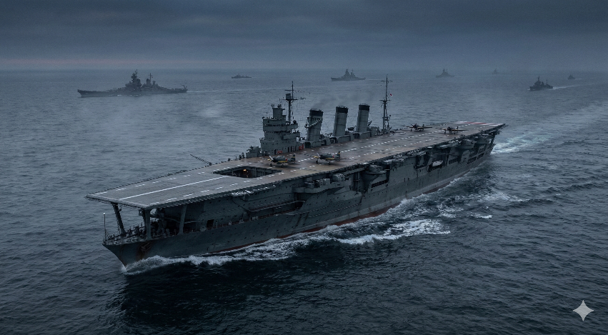
The Japanese Attack Fleet
Strike Force Strength
Aircraft Carriers
6
Battleships
2
Cruisers
3
Destroyers
11
Japanese Aircraft Carrier Akagi — Flagship of the Attack Fleet
Submarines
29
The fleet secretly sailed 3,500 miles across the North Pacific, maintaining complete radio silence to avoid detection.
Total Aircraft
414

Slide 6
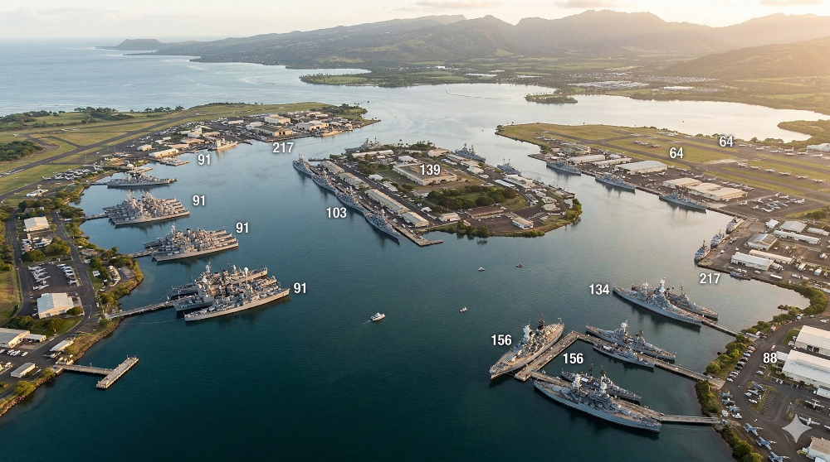
Pearl Harbor: America's Pacific Naval Base
Key Facts
Island Of Oahu, Hawaii
Home To The Entire US Pacific Fleet
3,700 Miles From The US Mainland
Over 100 Navy Ships Stationed Here
Considered Very Safe And Far From Enemies
Aerial view of Pearl Harbor, Oahu, Hawaii
A Quiet, Relaxed Sunday Morning...

Slide 7
December 7, 1941 — Hour by Hour
6:00 AM
183 Japanese planes take off from aircraft carriers north of Hawaii.
6:45 AM
USS Ward sinks a Japanese submarine. Warning sent to command — but ignored.
7:02 AM
Radar spots planes approaching. Officer assumes they are US B-17s. No alarm raised.
7:55 AM
BOMBS DROP! Wave 1 begins. Battleship Row targeted. Complete surprise achieved!
8:54 AM
Wave 2 of 167 aircraft arrives. Airfields and remaining ships bombed.
Attack ends. In under 2 hours, the US Pacific Fleet lies in ruins.
9:55 AM

Slide 8
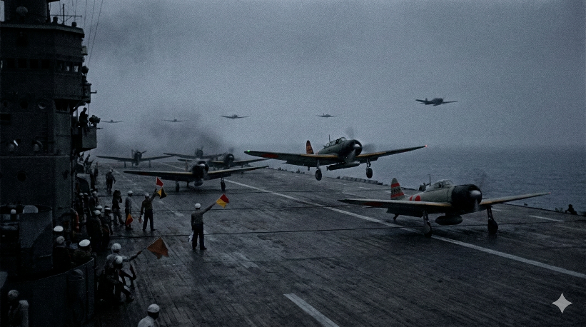
Wave 1: The First Strike — 7:55 AM
183 Aircraft — 4 Types Of Attack
✈ Torpedo Bombers (40 planes)
Attacked ships with underwater torpedoes.
✈ Dive Bombers (51 planes)
Dropped bombs directly onto ships from above.
✈ High-Level Bombers (49 planes)
Japanese planes launch from carrier. Pilots radio: 'Tora! Tora! Tora!'
Dropped heavy bombs from high altitude.
"TORA! TORA! TORA!"
(Tiger! Tiger! Tiger!)
✈ Fighter Planes (43 planes)
Destroyed US aircraft parked on the ground.

Slide 9
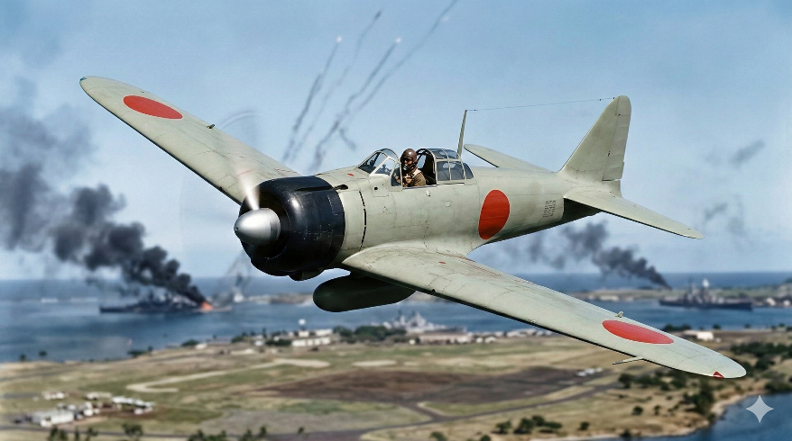
Wave 2: The Attack Continues — 8:54 AM
Second Wave Details
167 more planes — less than 1 hour after Wave 1
Main targets: airfields and remaining US aircraft
Also hit shipyards and fuel storage depots
By now, American anti-aircraft guns were firing back
29 Japanese planes were shot down during Wave 2
The attack ended at approximately 9:55 AM
Mitsubishi A6M Zero — Japan's fast and deadly fighter plane
The Zero was the most advanced fighter in the Pacific — faster and more agile than any US plane in 1941.
Total
350 Japanese aircraft attacked in under 2 hours!

Slide 10
The Sinking of USS Arizona
By the Numbers
The Most Famous Ship Lost at Pearl Harbor
At 8:10 AM, an armor-piercing bomb struck the USS Arizona's forward ammunition magazine — causing a massive explosion heard miles away.
The ship sank in just 9 minutes.
1,177 sailors and Marines died on the Arizona alone — nearly half of all Pearl Harbor deaths.
Today, the USS Arizona Memorial sits above the sunken ship. Oil still slowly seeps from the wreck — called the 'Tears of the Arizona.'
1,177
sailors killed on USS Arizona
9 min
time it took to sink
2
bomb hits sustained
1962
year the memorial opened

Slide 11
The Damage: Ships & Aircraft Lost
Major Ships Attacked
Total Impact
USS Arizona
Sunk
1,177 killed
21
USS Oklahoma
Capsized
429 killed
Ships hit
USS West Virginia
Sunk
Later raised & repaired
328
USS California
Sunk
Later raised & repaired
Aircraft destroyed
USS Nevada
Grounded
Later repaired
2,403
USS Shaw
Heavily damaged
Later repaired
Americans killed
USS Utah
Sunk
Never raised
1,178
USS Helena
Damaged
Later repaired
Americans wounded
Pear Harbor: A Day That Changed History | Slide 12 of 20

Slide 12
Heroes of Pearl Harbor
Doris Miller
Captain Mervyn Bennion
Messman, USS West Virginia
Commander, USS West Virginia
An African-American cook with no gunnery training, Miller manned an anti-aircraft gun and shot down enemy planes. He was the first Black American to receive the Navy Cross — a true everyday hero.
Mortally wounded on the bridge, he refused to leave his post and kept directing his crew until the very end. Awarded the Medal of Honor posthumously.
Diplomatic Failures
Japan's Decision
USS Oklahoma
USS Arizona
Held a flashlight to help trapped sailors escape the capsizing ship, knowing he could not save himself. Awarded the Medal of Honor for his selfless act.
Organized rescue operations on the burning Arizona under enemy fire. His calm leadership saved many lives. Awarded the Medal of Honor.
Pearl Harbor: A Day That Changed History | Slide 13 of 20

Slide 13
Japan's Losses & What They Missed
Japan's Cost
Also Not Destroyed
29 aircraft shot down
5 midget submarines destroyed
64 Japanese sailors killed
1 Japanese sailor captured
Japan also missed these critical targets:
Oil storage tanks (enough for months of war)
Repair shipyards and dry docks
Submarine base
Without oil and working repair facilities, many of the damaged ships could NEVER have been repaired and returned to battle.
Yamamoto reportedly said: "I fear all we have done is awaken a sleeping giant and fill him with a terrible resolve.
Japan's BIG Mistake
The US aircraft carriers were NOT at Pearl Harbor! They were at sea. Japan failed to destroy America's most powerful warships — a fatal strategic error.

Slide 14
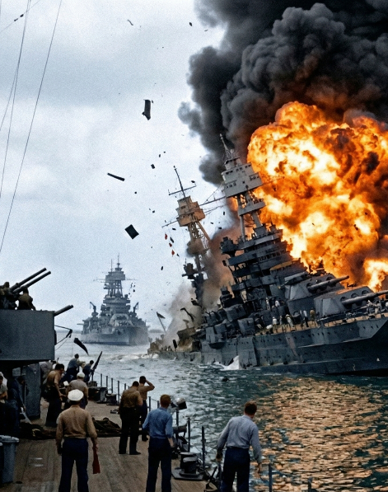
FDR's 'Day of Infamy' Speech
Address to Congress — December 8, 1941
"Yesterday, December 7, 1941 — a date which will live in infamy — the United States of America was suddenly and deliberately attacked by naval and air forces of the Empire of Japan..."
What happened after the speech?
Congress voted to declare war in just 33 minutes!
Only ONE member of Congress voted against the war.
Three days later, Germany and Italy declared war on the USA.
America was now fully committed to World War II.
President Franklin D. Roosevelt
32nd President of the USA
December 8, 1941
Address to Congress

Slide 15
Quellen
After Pearl Harbor — A Controversial Decision
Following the attack, fear and suspicion spread across America — especially toward Japanese-Americans living in the USA.
President Roosevelt signed Executive Order 9066 in February 1942.
About 120,000 Japanese-Americans — nearly two-thirds of whom were US citizens born in America — were forced into internment camps.
They lost their homes, businesses, and freedom — not because of anything they did, but simply because of their heritage.
This is now considered one of the most serious civil rights violations in American history.
In 1988, the US government formally apologized and paid reparations to surviving internees.

Slide 16
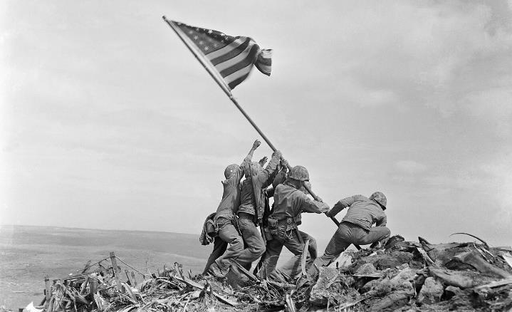
The USS Arizona Memorial
Built in 1962, the memorial sits directly above the sunken battleship in Pearl Harbor, Hawaii.
Names of all 1,177 sailors who died on the Arizona are carved into a marble wall inside the memorial.
The ship still holds the remains of those who could not be recovered.
Oil still seeps from the ship — called the 'Tears of the Arizona.'
Over 1.8 million people visit each year.
December 7 is National Pearl Harbor Remembrance Day in the United States.
The USS Arizona Memorial, Pearl Harbor, Hawaii
"Here lie our fallen comrades may their sacrifice never be forgotten."

Slide 17
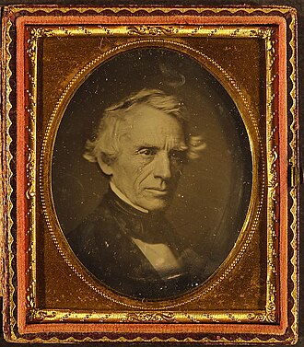
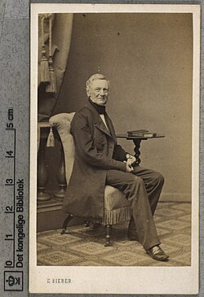
Massenmedium Fotografie
1839 Erfindung Daguerreotypie, erste kommerziell nutzbares Fotografie Verfahren
Gute, detailreiche Bilder, aber teuer wegen der Silberbeschichtung
Ab ca 1860 Visitenformat (Carte de Visite oder CdV)
Fotografie auf Karton ca 6x9 cm
Auch Visitkarton genannt
Erfinder unbekannt, am ehesten André Adolphe-Eugéne Disdéri
Schon deutlich günstigere Fotografie
Ende 19 Jhd. Brachten Erfindungen wie der Rollfilm (Kodak) noch weitere Verbreitung
Fotografie wird zum populären Medium für weite Teile des Bürgertums
Samuel Morse 1845
Daguerrotypie
E. Bieber 1869
Carte de Visite
Daguerrotypie:
Fotografie auf eine Glatte Metalloberfläche, anfangs versilberte Kupferplatten
Pearl Harbor: A Day That Changed History | Slide 16 of 20

Slide 18
Verbreitete Arten an Fotografie
Porträtfotografie
Post-Mortem Fotografie
Journalismusbilder
Mit das beliebteste Medium der Fotografie im 19. Jhd.
Von Ganzfigur bis nur Augenbereich alles
Bilder von verstorbenen. Oft bei verstorbenen Kindern als “schlafend” Dargestellt. Besonders Viktorianische Ära
Bilder von bekannten Leuten, aber auch Bilder von Orten und erste Journalismusfotografie im 19. Jhd.
Stereoskopie
Art von Fotografie die dem menschlichem Auge eine 3 Dimensionale Wahrnehmung vortäuscht
„Die Fotografie ist der Spiegel mit Gedächtnis.“ - Oliver Wendell Holmes Sr.

Slide 19
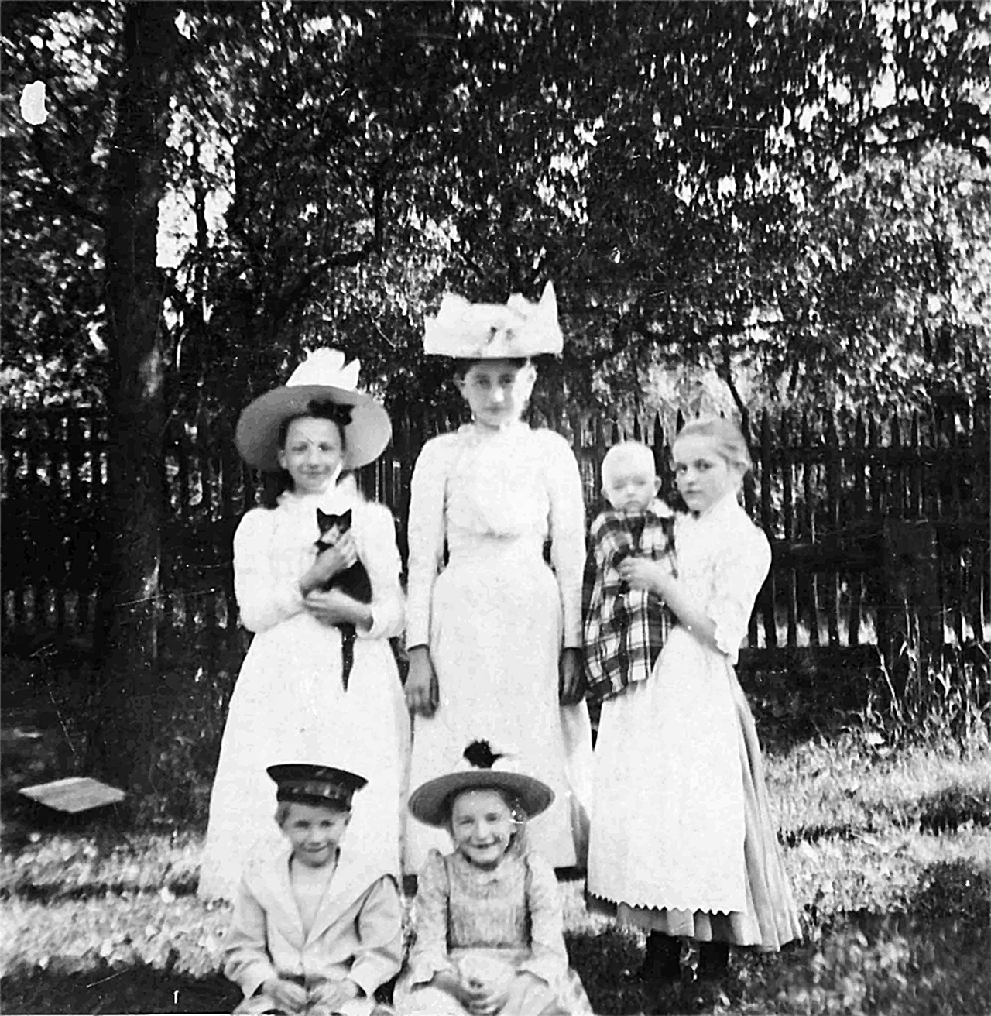
Beispiel Stereoskopie

Slide 20
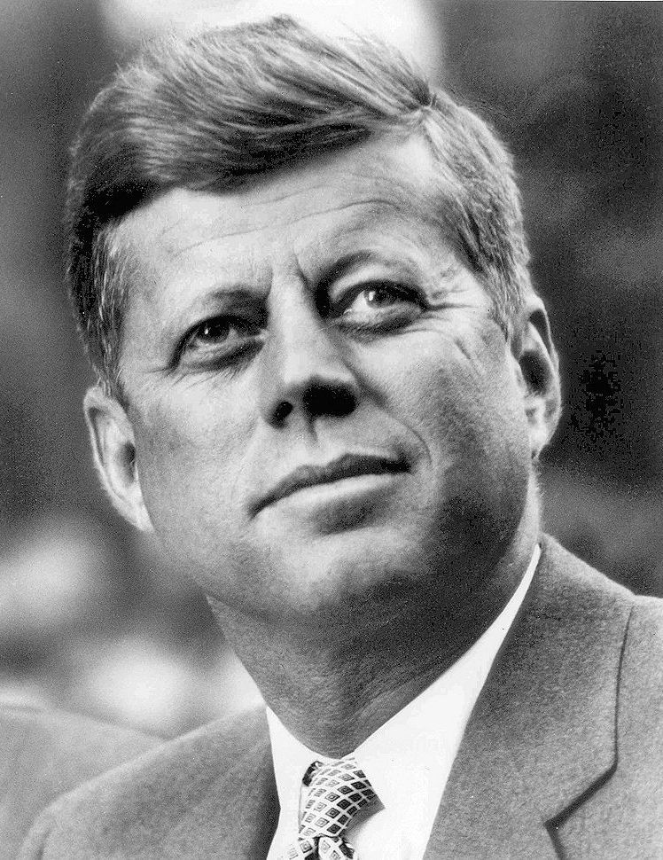
Porträtfotografie
Verschiedene Techniken
Objektive
Brennweite zw. 80mm – 135mm führt zu Verzerrungsfreier Wahrnehmung
Schärfentiefe
Setzt Person ab von Hintergrund oder auch Vordergrund
Oft auf Augenpartie fokussiert
Beleuchtung
z.B. Falten “wegleuchten” oder das Gesicht besonders Betonen indem die Stärke, Fläche oder Position der Lichtquelle entschieden wird
John F. Kennedy

Slide 21
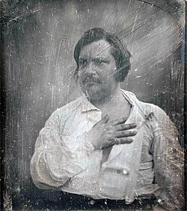
Inszenierungen
Bedeutungen
Repräsen
tation
Porträts sollen Status, Bildung, Stärke, Vermögen oder auch einfach generelle Interessen darstellen
Gegenstände oder Klamotten
Porträts die einen Job darstellen sollen, können Gegenstände wie Palette von Malern involvieren.
Das gleiche gilt für Klammotten wie Kittel
Künstlerisch
Piktorialismus. Mit Hilfe von Licht oder Objektiv eine künstlerische, manchmal übertriebene Darstellung eines Charakters
Honoré de Balzac 1842
Daguerrotypie
Gegen Ende 19. Jhd immer mehr spezifische Inszenierungen anstelle von spontanen Momenten

Slide 22
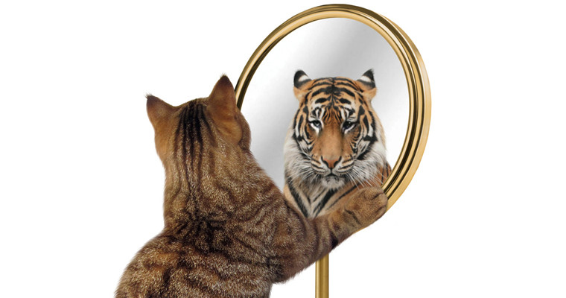
Selbstbild vs Fremdbild
Selbstbild
Fremdbild
Ideale Darstellung eines selbst und wie man sich selber sieht
Schlüsse auf die eigene Identität sind möglich
Oft realitätsabweichend
z.B. Instagram Influenzer, die nur die Positiven Dinge zeigen bzw nur bei gutem Aussehen zeigen
Zeigt mehr wie die Fotografierte Person auf Andere wirkt
Oft ehrlicheres und realitätsnahe Darstellung
Authentisch ohne idealisierte Inszenierung
Problem:
Bei Porträtfotografie muss Fotograf und Motiv stark kommunizieren damit beide am Ende zufrieden sind

Slide 23
Quellen
KEMP, Wolfgang. Geschichte der Fotografie. Von Daguerre bis Gursky, München, 2011
Bildquellen:
https://de.wikipedia.org/wiki/Portr%C3%A4tfotografie
https://de.wikipedia.org/wiki/Visitformat
https://www.das-pta-magazin.de/news/fremd-und-selbstbild-immer-eine-unstimmigkeit-2309630.html

Slide 24






Thank You!
We respect your valuable time with SlideEgg!
If you have any questions, please reach us
Do you have a design request, please visit our Deckez site.
CREDIT: SlideEgg created this PowerPoint template.
Let this slide be kept for attribution.
www.slideegg.com

